Slide 1
Neural Network Learning
The slides are mostly adopted from material developed by:
Dr. Aiman El-Maleh, KFUPM, COE Department

Slide 2
Outline
Neural Network Learning Problem
Neural Network Learning Problem Setup
Gradient Descent
Training Neural Nets through Gradient Descent
Stochastic and Mini-Batch Gradient Descent
Avoiding Overfitting during Neural Network Training: Dropout

Slide 3
Neural Networks
Neural networks are universal function approximators, where they can:
Model any Boolean function
Model any classification boundary
Model any continuous valued function
To approximate a given function, the neural network must satisfy minimal architecture constraints, i.e., the number of neuron per layer and the number of hidden layers must be sufficient to approximate the intended function.

Slide 4
Neural Network Learning
Neural Network architecture
Involves determining the number of layers in the network, the number of neurons in each layers and how neurons are connected
Feed-Forward Neural Network
Has No loops: Neuron outputs do not feed back to their inputs directly or indirectly
Neural Network parameters
The weights and biases
Neural Network Learning
Determining the values of the network parameters such that the network computes the desired function

Slide 5
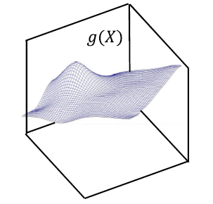
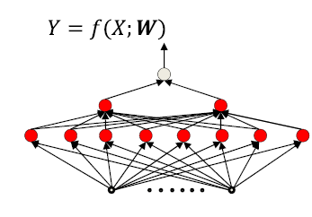
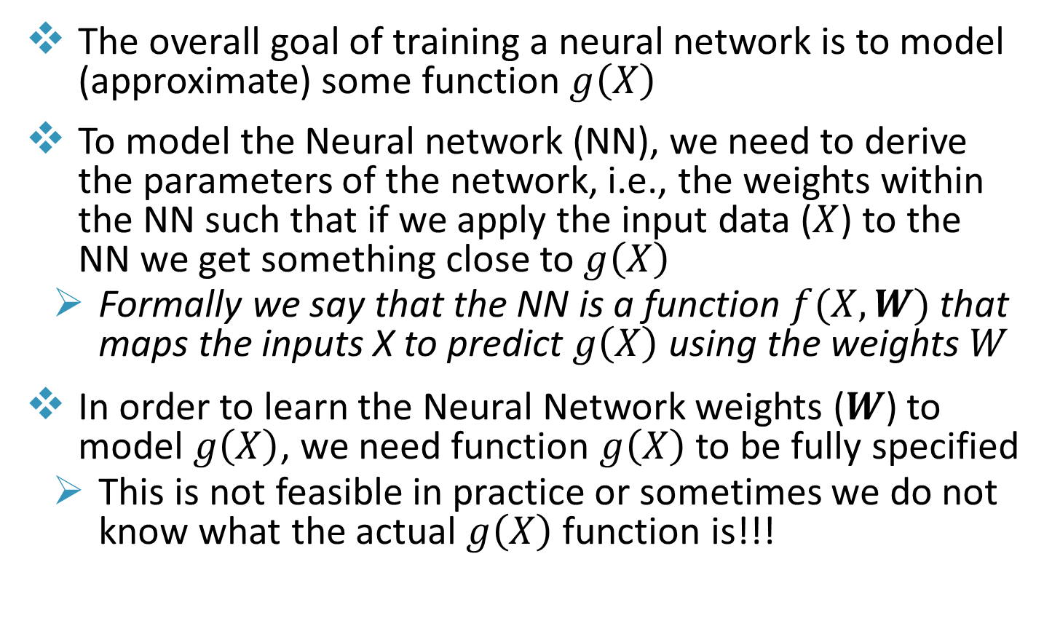
Neural Network Learning
The overall goal of training a neural network is to model (approximate) some function $g\left(X\right)$
To model the Neural network (NN), we need to derive the parameters of the network, i.e., the weights within the NN such that if we apply the input data ($X$) to the NN we get something close to $g\left(X\right)$
Formally we say that the NN is a function $f(X,W)$ that maps the inputs X to predict $g\left(X\right)$ using the weights $W$
In order to learn the Neural Network weights ($W$) to model $g\left(X\right)$, we need function $g\left(X\right)$ to be fully specified
This is not feasible in practice or sometimes we do not know what the actual $g\left(X\right)$ function is!!!

Slide 6
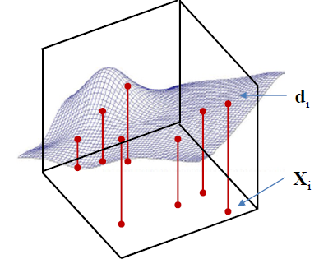
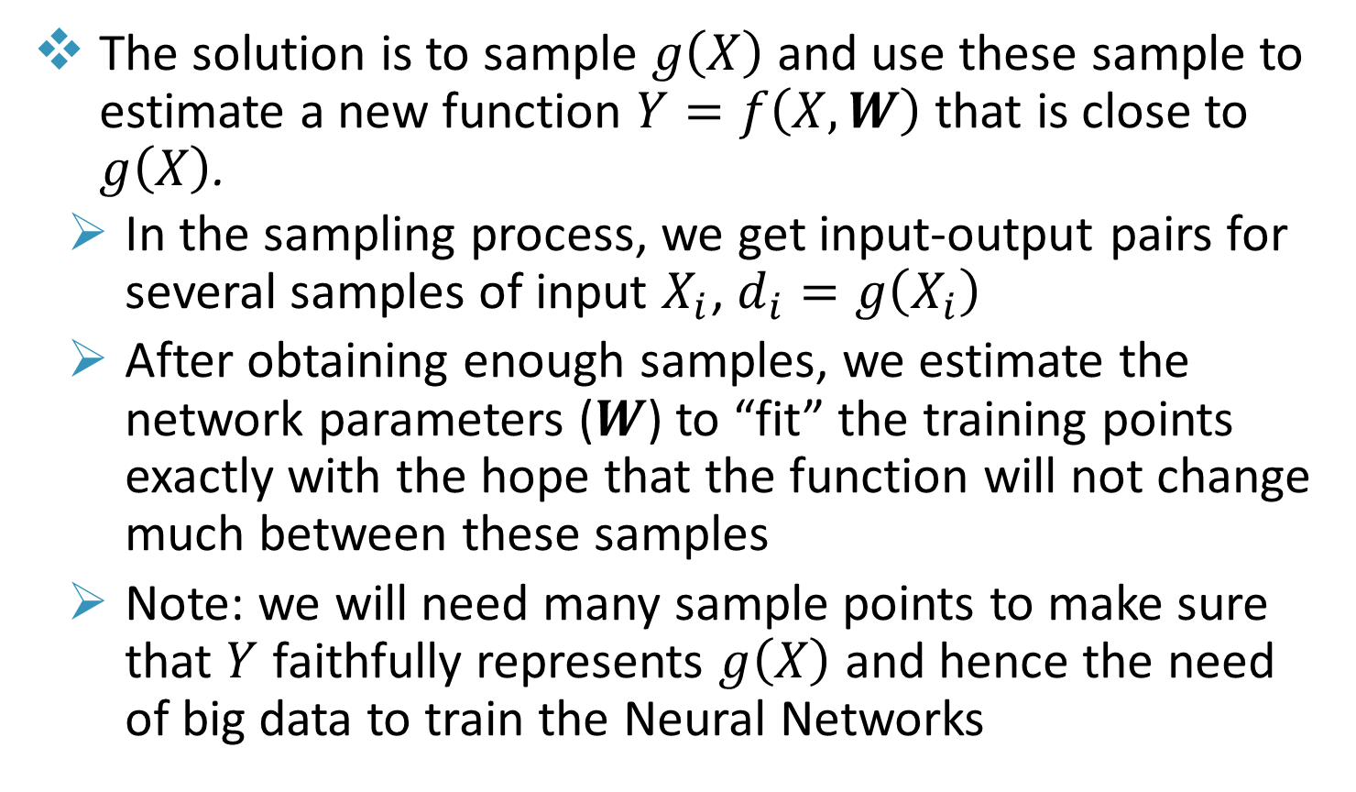
Neural Network Learning
The solution is to sample $g\left(X\right)$ and use these sample to estimate a new function $Y=f\left(X,W\right)$ that is close to $g\left(X\right)$.
In the sampling process, we get input-output pairs for several samples of input $X_{i}$, $d_{i}=g\left(X_{i}\right)$
After obtaining enough samples, we estimate the network parameters ($W$) to “fit” the training points exactly with the hope that the function will not change much between these samples
Note: we will need many sample points to make sure that $Y$ faithfully represents $g\left(X\right)$ and hence the need of big data to train the Neural Networks

Slide 7
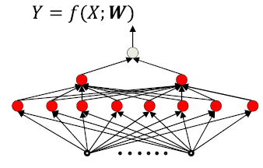
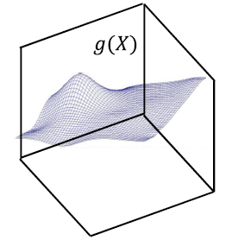
MLP Neural Network Learning
Given a neural network architecture and a training set of input-output pairs (X₁, d₁), (X₂, d₂), …, (X_{N}, d_{N})
d_{i} is the desired output of the network in response to X_{i}
We need to find the network parameters such that the network produces the desired output for each training input Or a close approximation of it

Slide 8
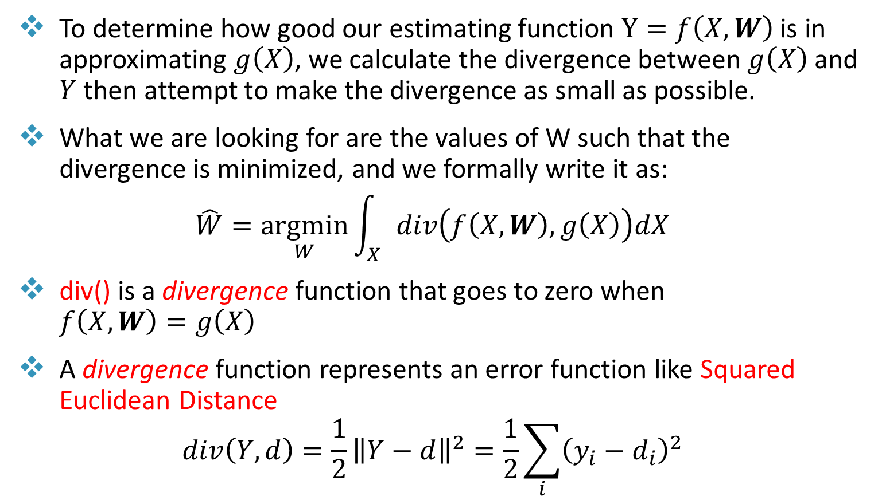
Neural Network Learning
To determine how good our estimating function $Y=f\left(X,W\right)$ is in approximating $g\left(X\right)$, we calculate the divergence between $g\left(X\right)$ and $Y$ then attempt to make the divergence as small as possible.
What we are looking for are the values of W such that the divergence is minimized, and we formally write it as:
$$\hat{W}=\underset{W}{argmin}{\int_{X}{div\left(f\left(X,W\right),g\left(X\right)\right)dX}}$$
div() is a divergence function that goes to zero when $f\left(X,W\right)=g\left(X\right)$
A divergence function represents an error function like Squared Euclidean Distance
$$div\left(Y,d\right)=\frac{1}{2}{\left\|Y−d\right\|}^{2}=\frac{1}{2}\sum_{i}{{\left(y_{i}−d_{i}\right)}^{2}}$$

Slide 9
Neural Network Learning Problem Setup
We assume a “layered” network for simplicity
We will refer to the inputs as the input layer
No neurons here – the “layer” simply refers to inputs
We refer to the outputs as the output layer
Intermediate layers are “hidden” layers

Slide 10
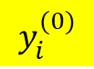
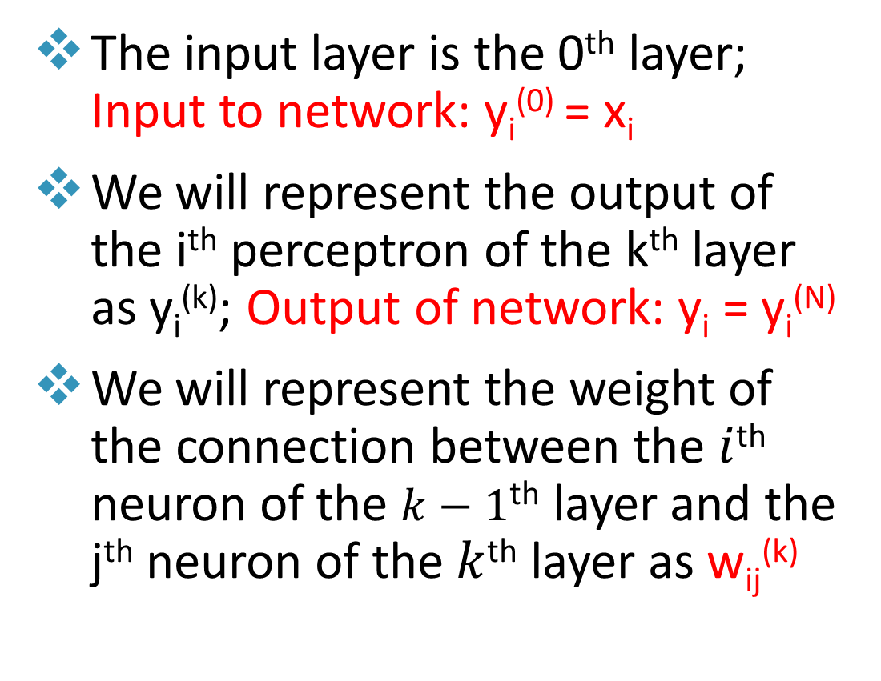
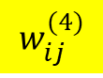
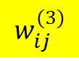
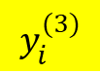
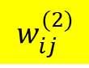
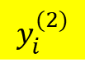
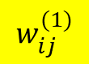
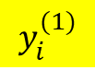
Neural Network Learning Problem Setup
The input layer is the 0th layer; Input to network: y_{i}⁽⁰⁾ = x_{i}
We will represent the output of the i^{th} perceptron of the k^{th} layer as y_{i}^{(k)}; Output of network: y_{i} = y_{i}^{(N)}
We will represent the weight of the connection between the $i$^{th} neuron of the $k−1$^{th} layer and the j^{th} neuron of the $k$^{th} layer as w_{ij}^{(k)}
$$w_{ij}^{(1)}$$
$$w_{ij}^{(2)}$$
$$w_{ij}^{(3)}$$
$$w_{ij}^{(4)}$$
$$y_{i}^{(0)}$$
$$y_{i}^{(1)}$$
$$y_{i}^{(2)}$$
$$y_{i}^{(3)}$$

Slide 11
Neural Network Learning Problem Setup
Examples:
w₂₁⁽²⁾ is shown in red
Y₂⁽⁰⁾ is shown in blue
Y₁⁽⁴⁾ is shown in brown
w₃₂⁽³⁾ is shown in green

Slide 12
Neural Network Learning Problem Setup
Vector Notation:
X_{n} = [x_{n1}, x_{n2}, …, x_{nD}] is the n^{th} input vector
d_{n} = [d_{n1}, d_{n2}, …, d_{nL}] is the n^{th} vector of desired output
Y_{n} = [y_{n1}, y_{n2}, …, y_{nL}] is the n^{th} vector of actual output
Input representation: vectors of numbers, e.g. vector of pixel values, real-valued vector representing text
Output representation
Single or a vector of real values
For binary classification: One binary output 1/0 e.g., cat/no cat
For multi-class output: one-hot representation is used e.g. [1 0 0], [0 1 0], [0 0 1]

Slide 13
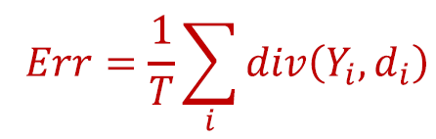
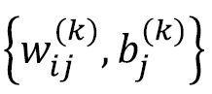
Neural Network Learning Problem Setup
Given a neural network architecture and a training set of input-output pairs (X₁, d₁), (X₂, d₂), …, (X_{T}, d_{T})
The error on the i^{th} instance is div(Y_{i}, d_{i})
Optimize network parameters to minimize the total error over all training inputs
The total error
Minimize Err w.r.t.
T is the number of input samples

Slide 14
A Simple Network Example

Slide 15
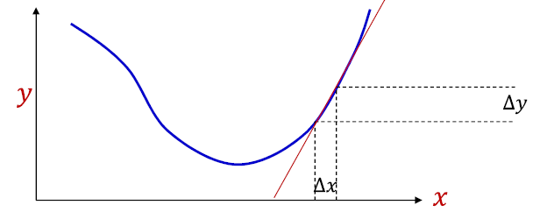
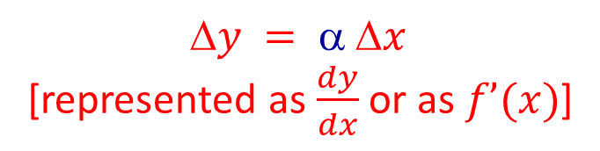
Neural Networks Learning
In order to minimize the error, we need to determine for each sample how the weights need to be adjusted to reduce the error
This can be done by examining the derivative of the error function with respect to each weight and determine whether the weight needs to be increased or decreased
The derivative of the error function with respect to a given weight determines the slope.
If the slope is positive this means that decreasing the weight will decrease the error
If the slope is negative this means that increasing the weight will decrease the error
$$y =  x$$
[represented as $\frac{dy}{dx}$ or as $f’(x)$]

Slide 16
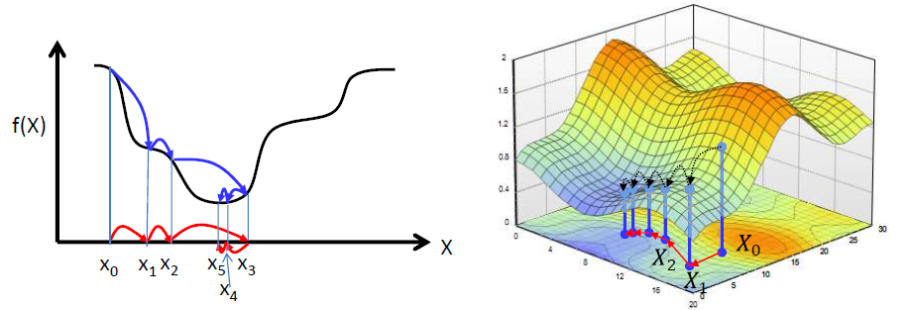
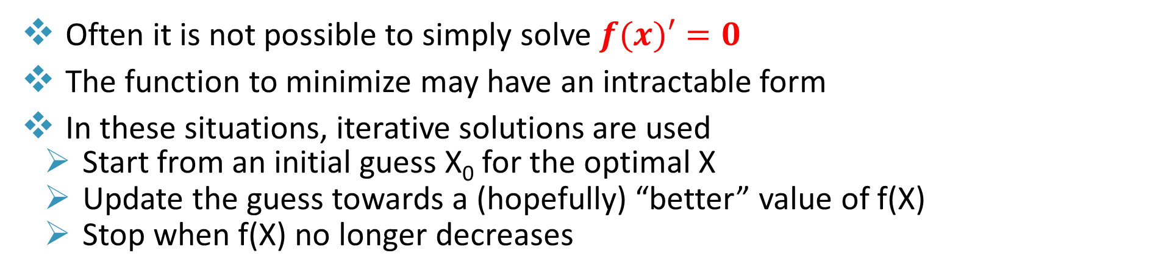
Iterative Solutions for Function Minimization
Often it is not possible to simply solve$f(x)′=0$
The function to minimize may have an intractable form
In these situations, iterative solutions are used
Start from an initial guess X₀ for the optimal X
Update the guess towards a (hopefully) “better” value of f(X)
Stop when f(X) no longer decreases

Slide 17
Gradient Descent
Algorithm for minimizing loss when training neural network
Gradient Descent Algorithm
Start with a random choice of weights.
Repeat:
Calculate the gradient based on all data points: direction that will lead to decreasing loss.
Update weights according to the gradient

Slide 18
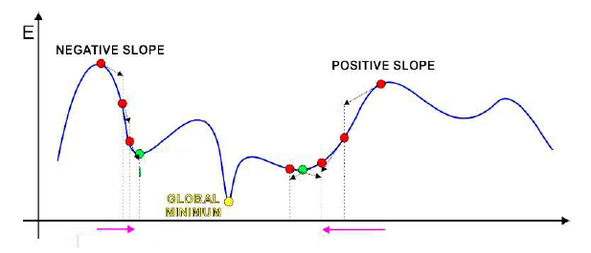
Gradient Descent
Iterative solution:
Start at some point
Find direction in which to shift this point to decrease error
This can be found from the derivative of the function
A positive derivative → moving left decreases error
A negative derivative → moving right decreases error
Shift point in this direction

Slide 19
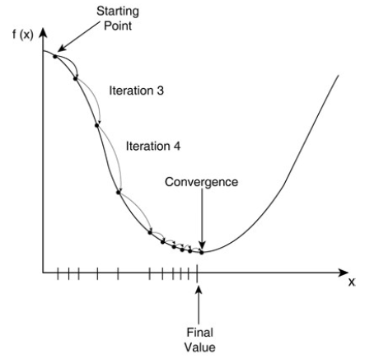
Gradient Descent
Initialize x⁰, k=0
While |f(X^{k+1})– f(X^{k})| > ε
x^{k+1} = x^{k} - η^{k} f’(x^{k})
k = k + 1
η^{k} is the “step size”
Many solutions to choosing step size η^{k}, usually iteration dependent

Slide 20
Gradient Descent Example
Given the function f(x₁, x₂, x₃)= (x₁)²+x₁(1-x₂)+(x₂)²-x₂x₃+(x₃)²+x₃
apply the gradient descent algorithm to minimize the function starting with the initial solution (x₁,x₂ ,x₃)=(1,1,1) using a learning rate η=0.3
f’x₁ = 2x₁+1- x₂, f’x₁ = 2
f’x₂ = -x₁+2x₂-x₃, f’x₂ = 0
f’x₃ = -x₂+2x₃+1, f’x₃ =2
x₁ = x₁ – η f’x₁ = 1 – 0.3*2 = 0.4
x₂ = x₂ – η f’x₂ = 1 – 0.3*0 = 1
x₃ = x₃ – η f’x₃ = 1 – 0.3*2 = 0.4

Slide 21
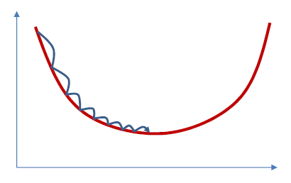
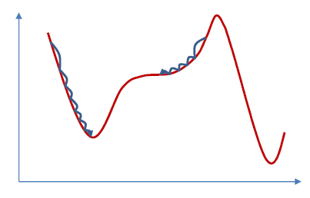
Convergence of Gradient Descent
For appropriate step size, for convex (bowl-shaped) functions, gradient descent will always find the minimum
For non-convex functions it will find a local minimum or an inflection point

Slide 22
Convergence of Gradient Descent
How fast or slow do we move our point to the optimum point is controlled by step size and denoted by η.
The effect of step size (η) is as follows:
For η < η_{𝑜𝑝𝑡}, the algorithm will converge monotonically and may require many steps
For η = η_{𝑜𝑝𝑡}, the algorithm will reach to the optimal solution in one step
For 2η_{𝑜𝑝𝑡} > η > η_{𝑜𝑝𝑡}, we have oscillating convergence → may converge but requires too many steps to reach to the optimum solution
For η > 2η_{𝑜𝑝𝑡}, we get divergence

Slide 23
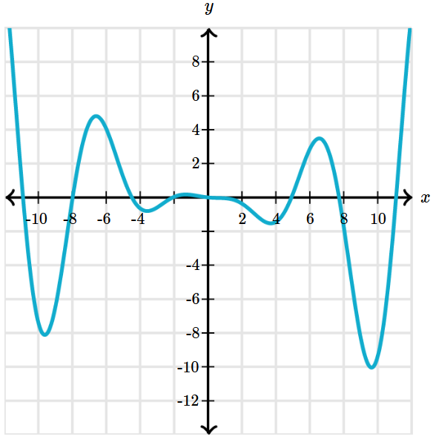
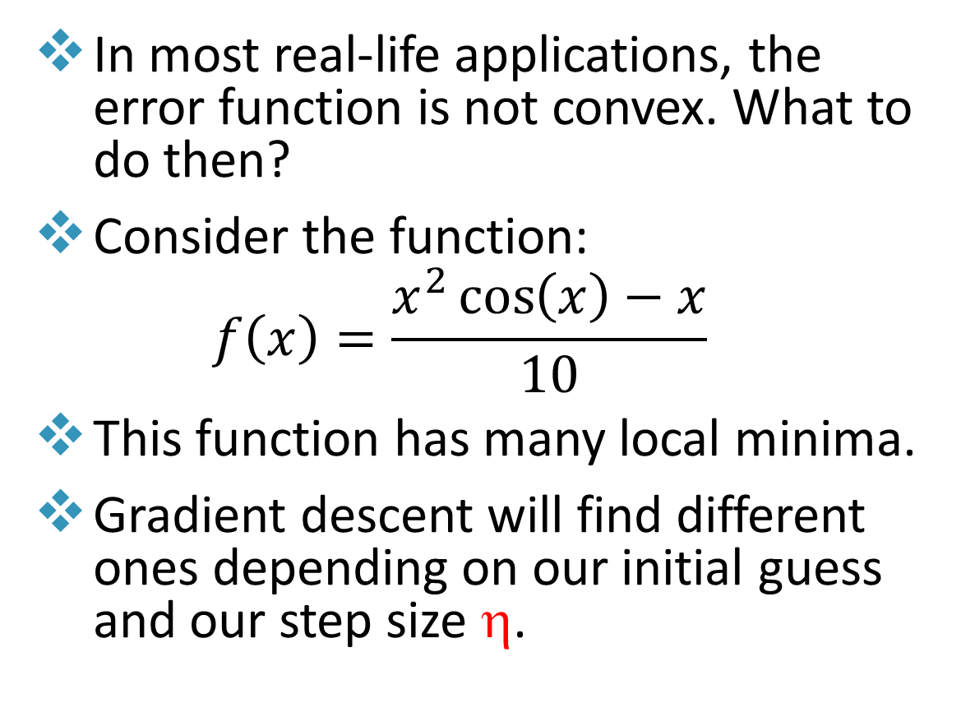
Gradient Descent Example
In most real-life applications, the error function is not convex. What to do then?
Consider the function:
$$f\left(x\right)=\frac{x^{2}\cos\left(x\right)−x}{10}$$
This function has many local minima.
Gradient descent will find different ones depending on our initial guess and our step size η.

Slide 24
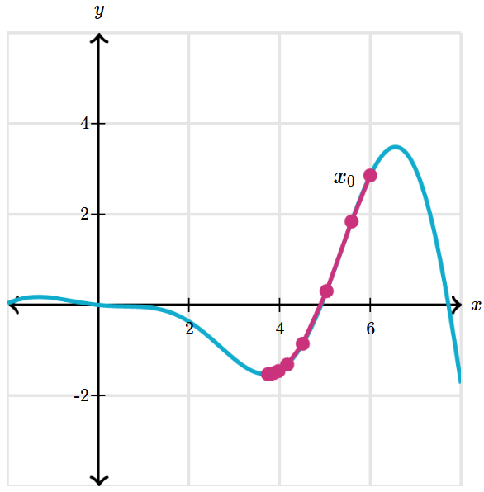
Gradient Descent Example
If we choose 𝑥₀=6 and η =0.2, for example, gradient descent moves as shown in the graph below. The first point is 𝑥₀ and the gradient suggests to move to the left. After only 10 steps, we have converged to the local minimum near 𝑥=4.

Slide 25
Gradient Descent Example
We then get stuck on the local minimum.
We choose η >2 η_{𝑜𝑝𝑡} and get a new point outside the local minimum valley and then do the gradient decent again to find other local minima.
We repeat multiple times and then choose the one that is the lowest.
Note: in real applications and depending on the complexity of the error curve, you may not reach the global minimum value.

Slide 26
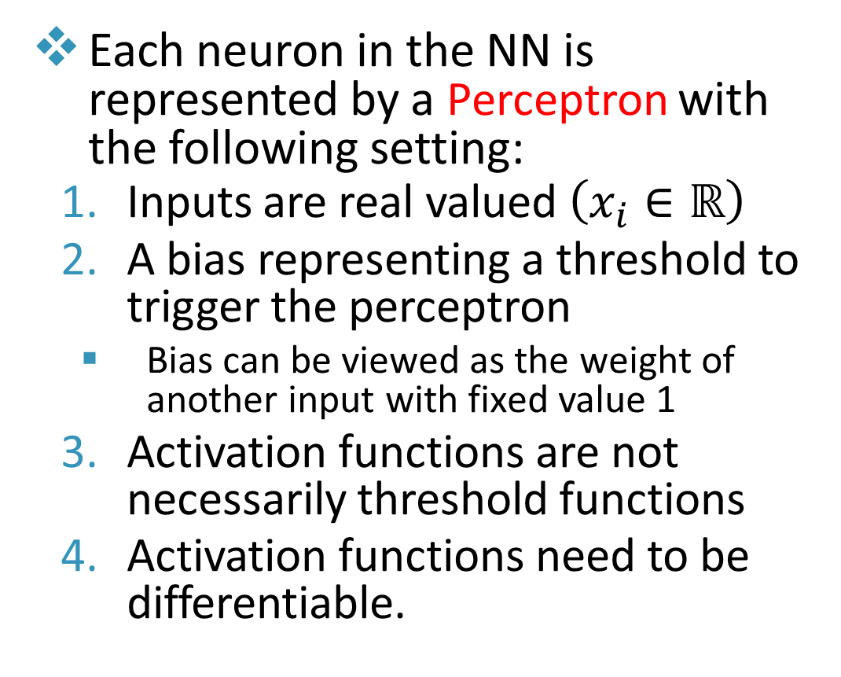
Neural Network (NN) Units
Each neuron in the NN is represented by a Perceptron with the following setting:
Inputs are real valued $\left(x_{i}∈ℝ\right)$
A bias representing a threshold to trigger the perceptron
Bias can be viewed as the weight of another input with fixed value 1
Activation functions are not necessarily threshold functions
Activation functions need to be differentiable.

Slide 27
Activation Functions
Why do we need Activation Functions in Neural Networks?
The purpose of an activation function is to add non-linearity to the neural network.
Let’s suppose we have a neural network working without the activation functions. In that case:
Every neuron will only be performing a linear transformation on the inputs using the weights and biases.
All layers will behave in the same way because the composition of two linear functions is a linear function itself.
Learning complex task is impossible, and our model would be just a linear regression model.
https://www.v7labs.com/blog/neural-networks-activation-functions

Slide 28
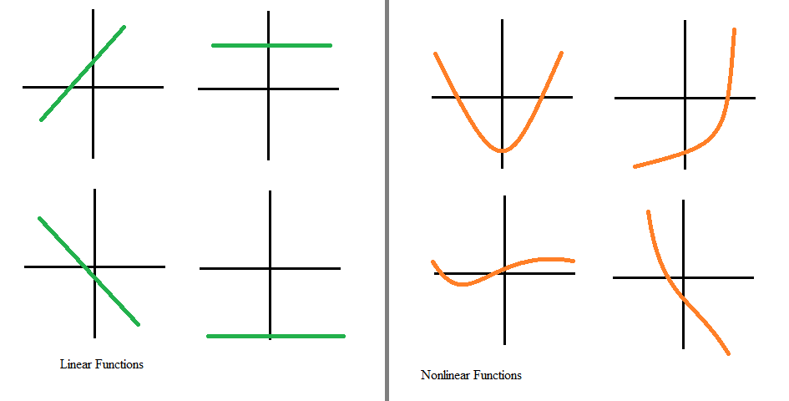
Activation Functions
Linear activation functions:
It’s not possible to use backpropagation as the derivative of the function is a constant and has no relation to the input x
A linear activation function turns the neural network into just one layer where all layers of the neural network will collapse into one if a linear activation function is used
Non-linear activation functions:
They allow backpropagation because now the derivative function would be related to the input, and it’s possible to go back and understand which weights in the input neurons can provide a better prediction
They allow the stacking of multiple layers where the output can be represented as a functional computation in a neural network
https://www.v7labs.com/blog/neural-networks-activation-functions

Slide 29
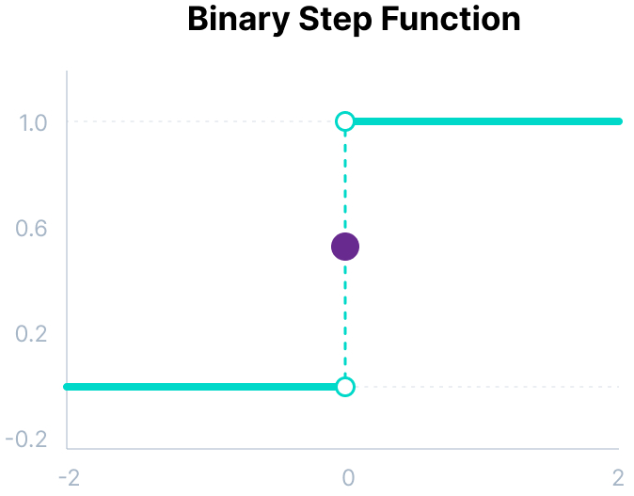
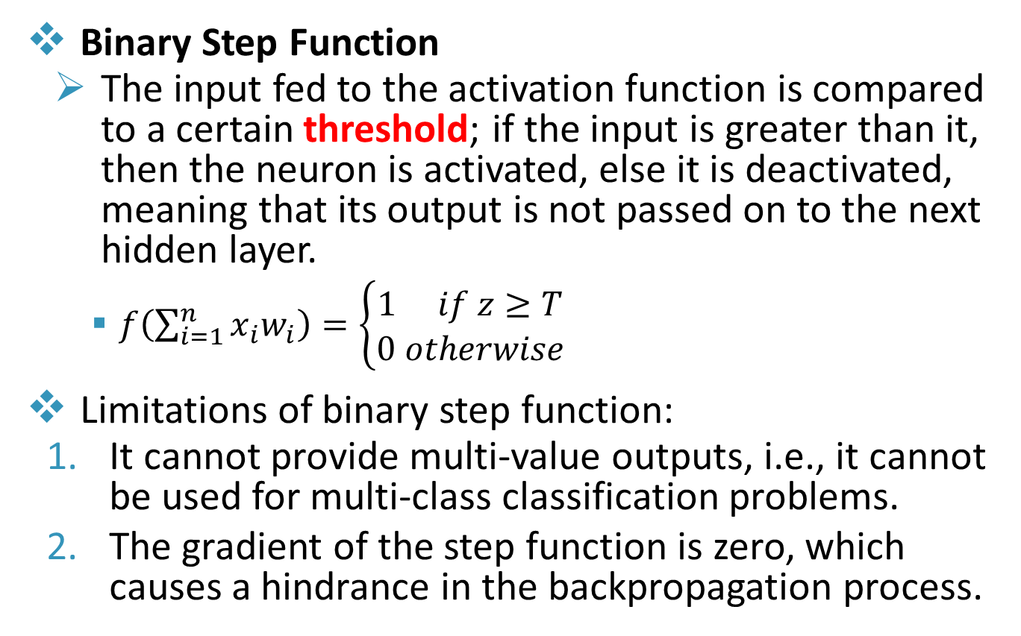
Activation Functions
Binary Step Function
The input fed to the activation function is compared to a certain threshold; if the input is greater than it, then the neuron is activated, else it is deactivated, meaning that its output is not passed on to the next hidden layer.
$f\left(\sum_{i=1}^{n}{x_{i}w_{i}}\right)=\left\{\begin{matrix}1 if z≥T \\ 0 otherwise\end{matrix}\right.$
Limitations of binary step function:
It cannot provide multi-value outputs, i.e., it cannot be used for multi-class classification problems.
The gradient of the step function is zero, which causes a hindrance in the backpropagation process.
https://www.v7labs.com/blog/neural-networks-activation-functions

Slide 30
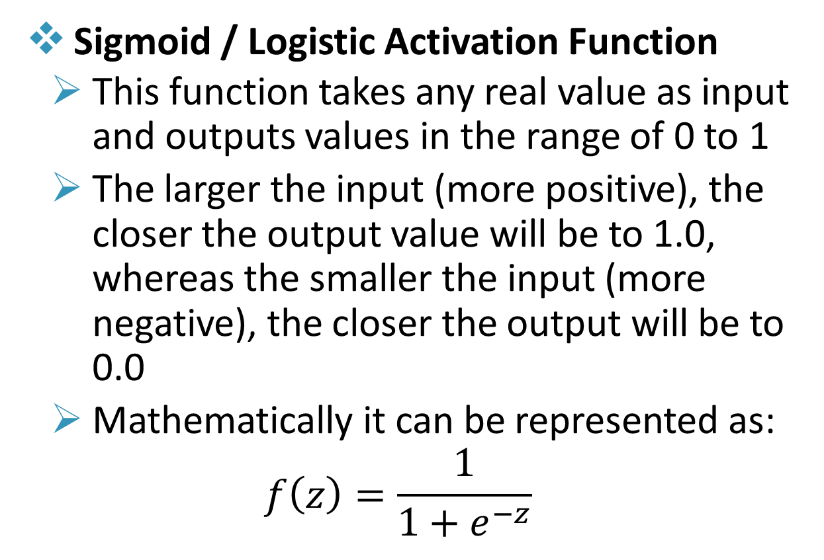
Activation Functions (Sigmoid/logistic Activation)
Sigmoid / Logistic Activation Function
This function takes any real value as input and outputs values in the range of 0 to 1
The larger the input (more positive), the closer the output value will be to 1.0, whereas the smaller the input (more negative), the closer the output will be to 0.0
Mathematically it can be represented as:
$$f\left(z\right)=\frac{1}{1+e^{−z}}$$
https://www.v7labs.com/blog/neural-networks-activation-functions

Slide 31
Activation Functions (Sigmoid/logistic Activation)
Sigmoid/logistic activation function is one of the most widely used functions because:
Used when we must predict the probability as an output. Since probability only exists between 0 and 1, sigmoid is the right choice.
The function is differentiable and provides a smooth gradient, i.e., preventing jumps in output values.
https://www.v7labs.com/blog/neural-networks-activation-functions

Slide 32
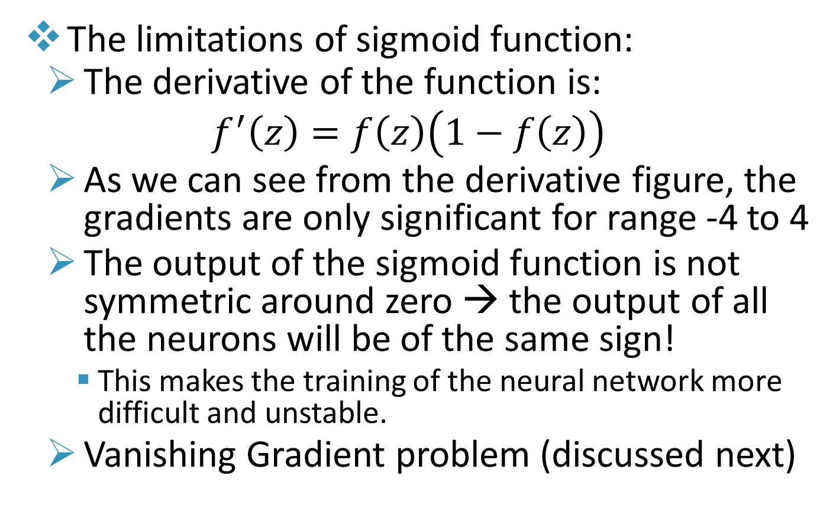
Activation Functions (Sigmoid/logistic Activation)
The limitations of sigmoid function:
The derivative of the function is:
$$f^{′}\left(z\right)=f\left(z\right)\left(1−f\left(z\right)\right)$$
As we can see from the derivative figure, the gradients are only significant for range -4 to 4
The output of the sigmoid function is not symmetric around zero → the output of all the neurons will be of the same sign!
This makes the training of the neural network more difficult and unstable.
Vanishing Gradient problem (discussed next)
https://www.v7labs.com/blog/neural-networks-activation-functions

Slide 33
Activation Functions (Sigmoid/logistic Activation)
Vanishing Gradient problem in Sigmoid:
Sigmoid squishes the entire input space into a small output space between 0 and 1
Therefore, a large change in the input of the sigmoid function will cause a small change in the output. Hence, the derivative becomes small.
For shallow networks with only a few hidden layers that use these activations, this isn’t a big problem. However, when more layers are used, it can cause the gradient to be too small for training to work effectively.
https://www.v7labs.com/blog/neural-networks-activation-functions

Slide 34
Activation Functions (Tanh Activation)
Tanh Function (Hyperbolic Tangent)
Tanh function is very similar to the sigmoid/logistic activation function, with the difference in output range of -1 to 1
Advantages:
The output is Zero centered; hence we can map the output values as strongly negative, neutral, or strongly positive.
Usually used in hidden layers of a neural network as its values lie between -1 to 1. It helps in centering the data and makes learning for the next layer much easier.
https://www.v7labs.com/blog/neural-networks-activation-functions

Slide 35
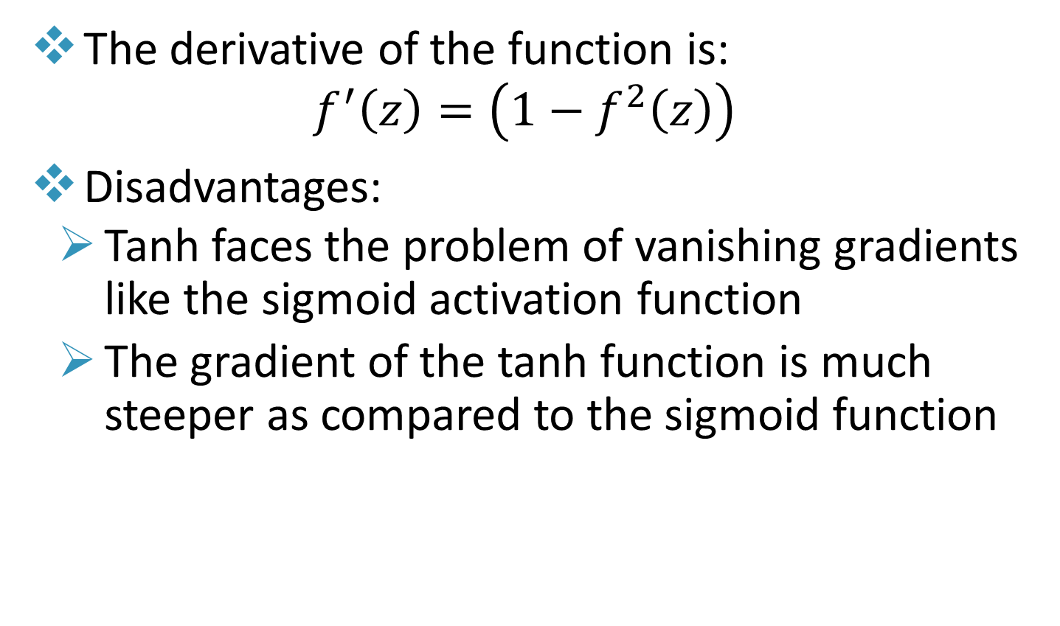
Activation Functions (Tanh Activation)
The derivative of the function is:
$$f^{′}\left(z\right)=\left(1−f^{2}\left(z\right)\right)$$
Disadvantages:
Tanh faces the problem of vanishing gradients like the sigmoid activation function
The gradient of the tanh function is much steeper as compared to the sigmoid function
https://www.v7labs.com/blog/neural-networks-activation-functions

Slide 36
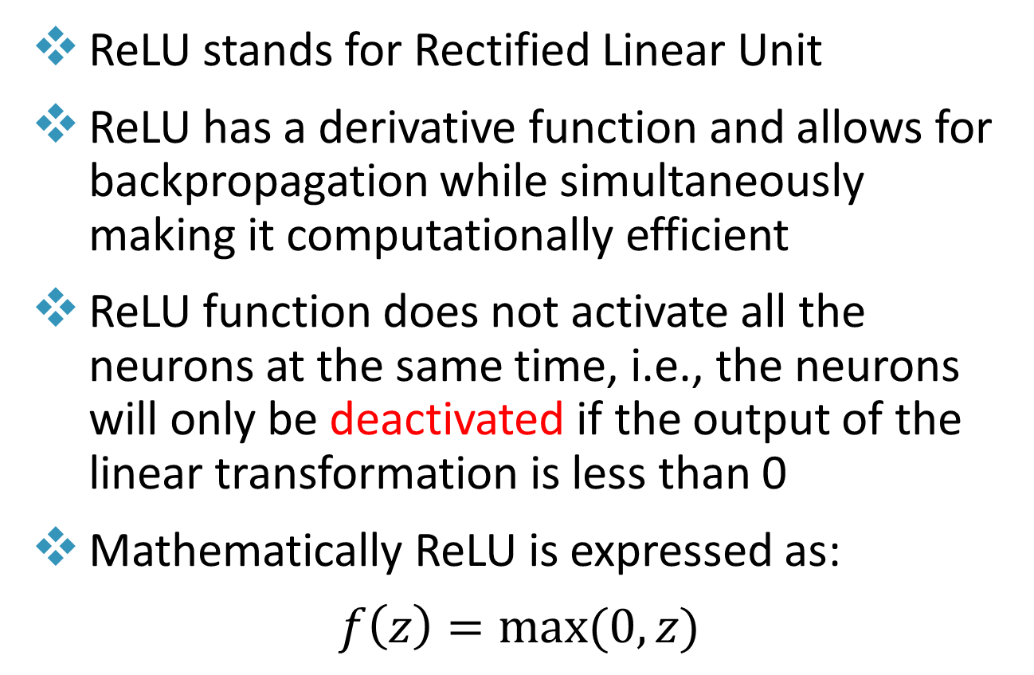
Activation Functions (ReLU Activation)
ReLU stands for Rectified Linear Unit
ReLU has a derivative function and allows for backpropagation while simultaneously making it computationally efficient
ReLU function does not activate all the neurons at the same time, i.e., the neurons will only be deactivated if the output of the linear transformation is less than 0
Mathematically ReLU is expressed as:
$f\left(z\right)=max⁡(0,z)$
https://www.v7labs.com/blog/neural-networks-activation-functions

Slide 37
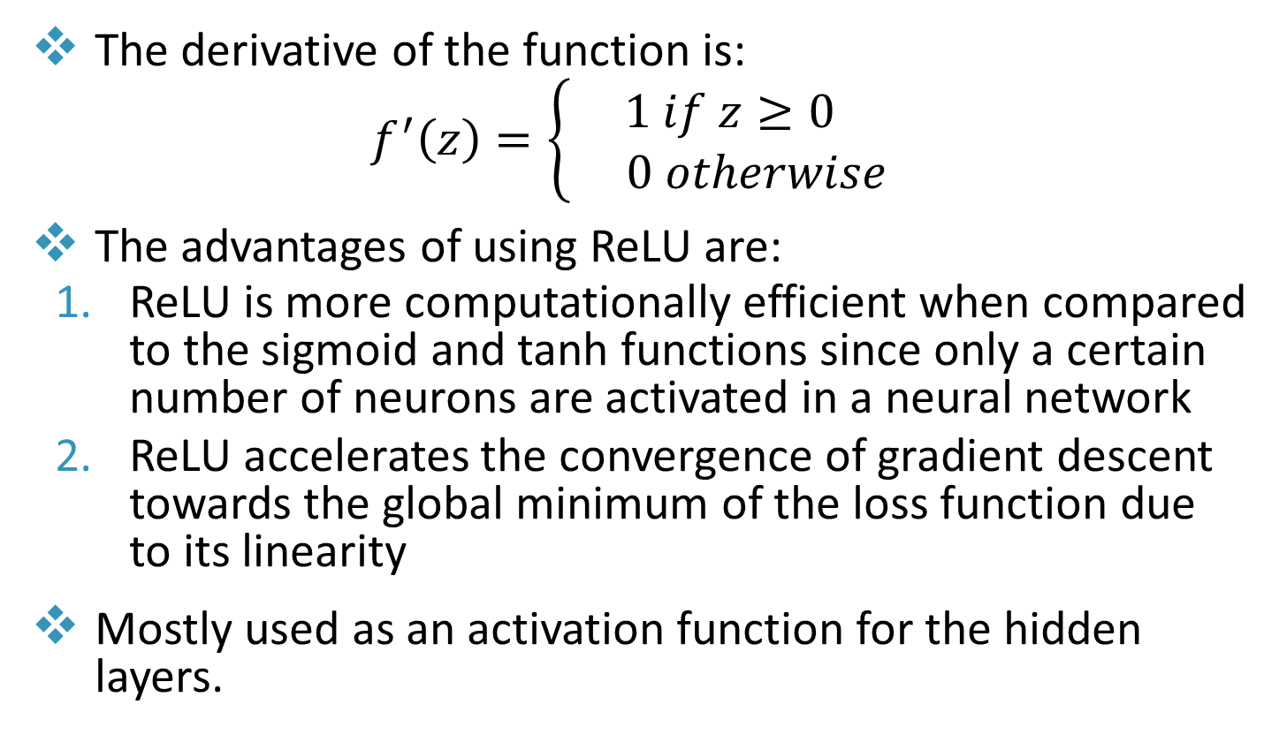
Activation Functions (ReLU Activation)
The derivative of the function is:
$$f^{′}\left(z\right)=\left\{\begin{matrix}1 if z≥0 \\ 0 otherwise\end{matrix}\right.$$
The advantages of using ReLU are:
ReLU is more computationally efficient when compared to the sigmoid and tanh functions since only a certain number of neurons are activated in a neural network
ReLU accelerates the convergence of gradient descent towards the global minimum of the loss function due to its linearity
Mostly used as an activation function for the hidden layers.
https://www.v7labs.com/blog/neural-networks-activation-functions

Slide 38
Activation Functions (ReLU Activation)
Limitations:
All the negative input values become zero immediately, which decreases the model’s ability to fit or train from the data properly.
The negative side of the graph makes the gradient value zero. Due to this reason, during the backpropagation process, the weights and biases for some neurons are not updated. This can create dead neurons which never get activated.
https://www.v7labs.com/blog/neural-networks-activation-functions

Slide 39
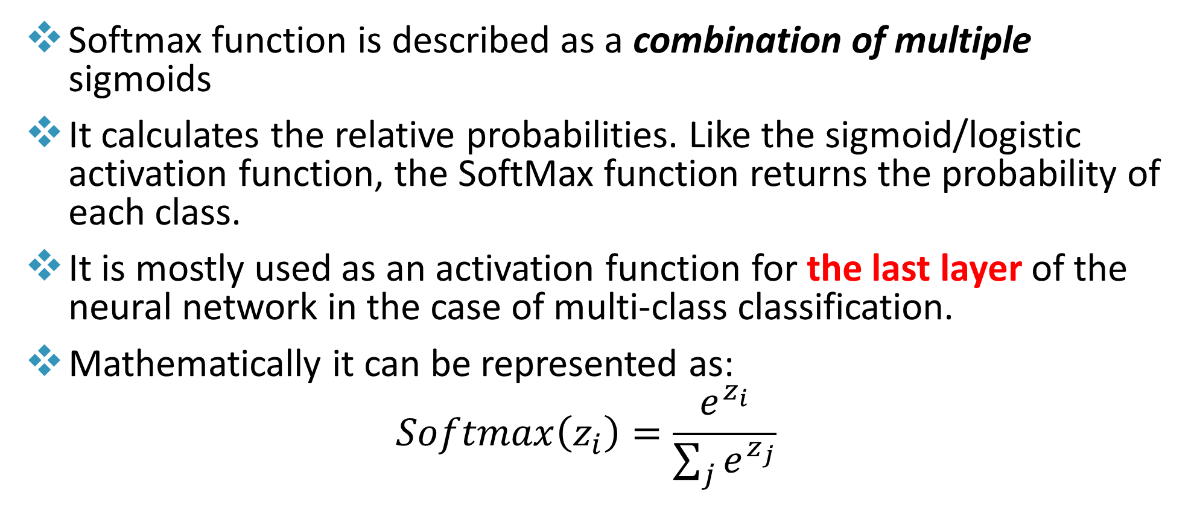
Activation Functions (Softmax Activation)
Softmax function is described as a combination of multiple sigmoids
It calculates the relative probabilities. Like the sigmoid/logistic activation function, the SoftMax function returns the probability of each class.
It is mostly used as an activation function for the last layer of the neural network in the case of multi-class classification.
Mathematically it can be represented as:
$$Softmax\left(z_{i}\right)=\frac{e^{z_{i}}}{\sum_{j}{e^{z_{j}}}}$$
https://www.v7labs.com/blog/neural-networks-activation-functions

Slide 40
How to Choose the Right Activation Function?
Match your activation function for your output layer based on the type of prediction problem that you are solving
Begin with using the ReLU activation function and then move over to other activation functions if ReLU doesn’t provide optimum results
Guidelines of choosing Activation Functions:
ReLU activation function should only be used in the hidden layers.
Sigmoid/Logistic and Tanh functions should not be used in hidden layers for high depth networks as they make the model more susceptible to problems during training (due to vanishing gradients).
https://www.v7labs.com/blog/neural-networks-activation-functions

Slide 41
Activation Functions Summary
Activation Functions are used to introduce non-linearity in the network
A neural network will almost always have the same activation function in all hidden layers. This activation function should be differentiable so that the parameters of the network are learned in backpropagation.
ReLU is the most commonly used activation function for hidden layers.
While selecting an activation function, you must consider the problems it might face such as vanishing gradients.
https://www.v7labs.com/blog/neural-networks-activation-functions

Slide 42
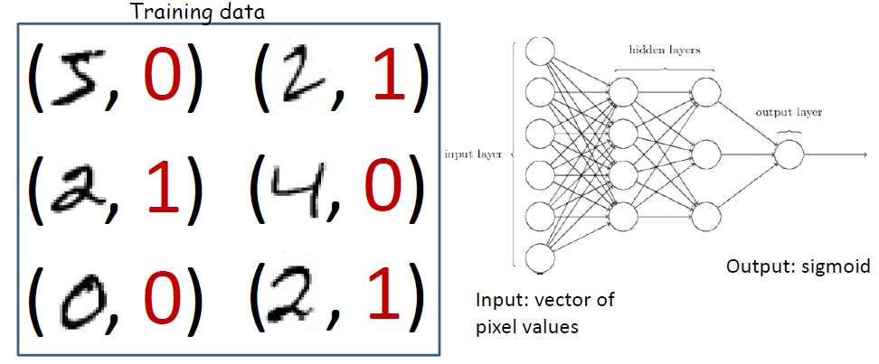
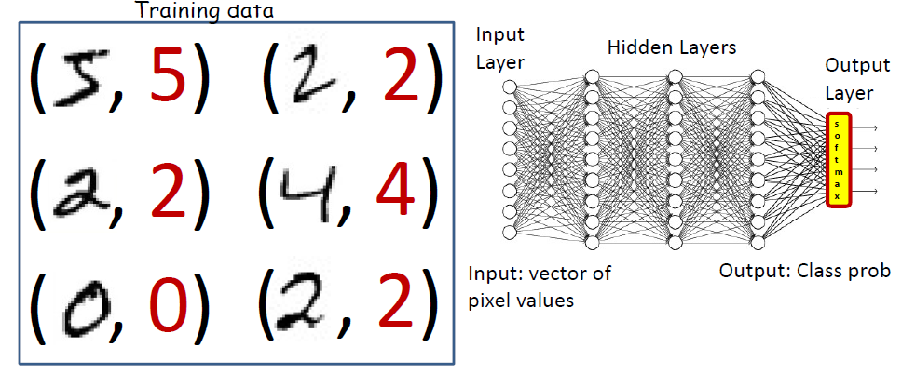
Typical Problem Statement: Classification
Binary Classification
Multi-Class Classification

Slide 43
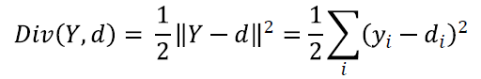
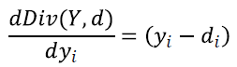
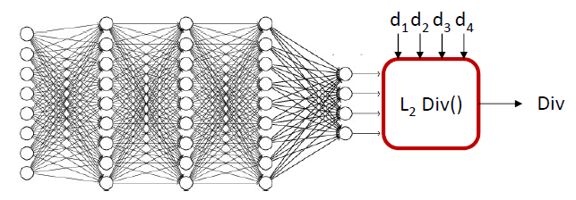
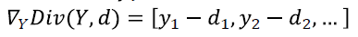
Examples of Divergence Functions
For real-valued output vectors, the (scaled) divergence representing Squared Euclidean Distance between true and desired output is popular:
The divergence function is differentiable
Gradient:

Slide 44
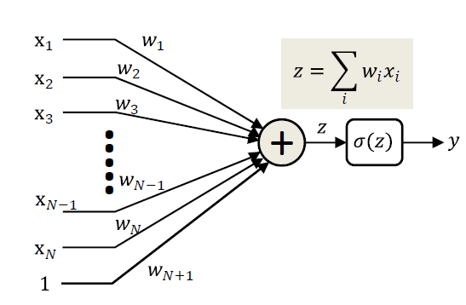
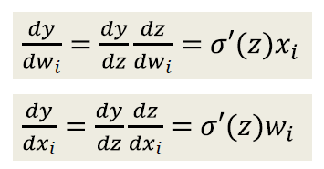
Perceptrons with Differentiable Activation Functions
Activation functions need to be differentiable
σ(z) is a differentiable function of z
Using the chain rule, y is a differentiable function of both inputs x_{𝒊} and weights w_{𝒊}
We can compute the change in the output for small changes in either the input or the weights

Slide 45
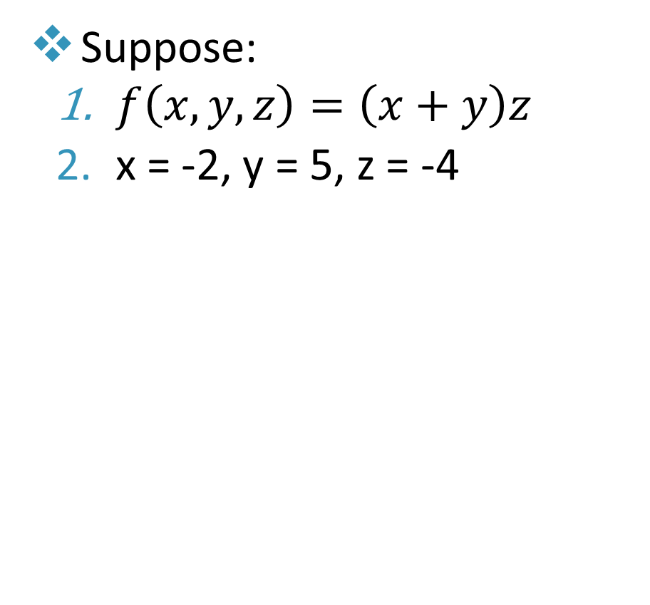
Backpropagation Simple Example
Suppose:
$f\left(x,y,z\right)=\left(x+y\right)z$
x = -2, y = 5, z = -4

Slide 46
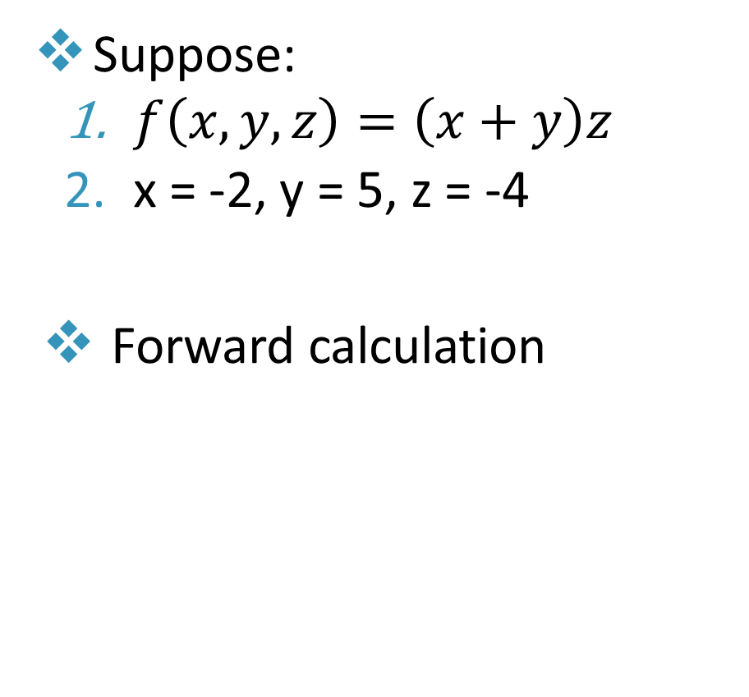
Backpropagation Simple Example
Suppose:
$f\left(x,y,z\right)=\left(x+y\right)z$
x = -2, y = 5, z = -4
Forward calculation

Slide 47

Backpropagation Simple Example
Suppose:
$f\left(x,y,z\right)=\left(x+y\right)z$
x = -2, y = 5, z = -4
$q=x+y→\frac{∂q}{∂x}=1,\frac{∂q}{∂y}=1$

Slide 48

Backpropagation Simple Example
Suppose:
$f\left(x,y,z\right)=\left(x+y\right)z$
x = -2, y = 5, z = -4
$q=x+y→\frac{∂q}{∂x}=1,\frac{∂q}{∂y}=1$
$f=q×z→\frac{∂f}{∂q}=z,\frac{∂f}{∂z}=q$

Slide 49

Backpropagation Simple Example
Suppose:
$f\left(x,y,z\right)=\left(x+y\right)z$
x = -2, y = 5, z = -4
$q=x+y→\frac{∂q}{∂x}=1,\frac{∂q}{∂y}=1$
$f=q×z→\frac{∂f}{∂q}=z,\frac{∂f}{∂z}=q$
We want:
$$\frac{∂f}{∂x},\frac{∂f}{∂y},\frac{∂f}{∂z}$$

Slide 50

Backpropagation Simple Example
Suppose:
$f\left(x,y,z\right)=\left(x+y\right)z$
x = -2, y = 5, z = -4
$q=x+y→\frac{∂q}{∂x}=1,\frac{∂q}{∂y}=1$
$f=q×z→\frac{∂f}{∂q}=z,\frac{∂f}{∂z}=q$
We want:
$$\frac{∂f}{∂x},\frac{∂f}{∂y},\frac{∂f}{∂z}$$
$$\frac{∂f}{∂f}$$

Slide 51
Backpropagation Simple Example
Suppose:
$f\left(x,y,z\right)=\left(x+y\right)z$
x = -2, y = 5, z = -4
$q=x+y→\frac{∂q}{∂x}=1,\frac{∂q}{∂y}=1$
$f=q×z→\frac{∂f}{∂q}=z,\frac{∂f}{∂z}=q$
We want:
$$\frac{∂f}{∂x},\frac{∂f}{∂y},\frac{∂f}{∂z}$$
1
$$\frac{∂f}{∂f}$$

Slide 52

Backpropagation Simple Example
Suppose:
$f\left(x,y,z\right)=\left(x+y\right)z$
x = -2, y = 5, z = -4
$q=x+y→\frac{∂q}{∂x}=1,\frac{∂q}{∂y}=1$
$f=q×z→\frac{∂f}{∂q}=z,\frac{∂f}{∂z}=q$
We want:
$$\frac{∂f}{∂x},\frac{∂f}{∂y},\frac{∂f}{∂z}$$
1
$$\frac{∂f}{∂z}$$

Slide 53
Backpropagation Simple Example
Suppose:
$f\left(x,y,z\right)=\left(x+y\right)z$
x = -2, y = 5, z = -4
$q=x+y→\frac{∂q}{∂x}=1,\frac{∂q}{∂y}=1$
$f=q×z→\frac{∂f}{∂q}=z,\frac{∂f}{∂z}=q$
We want:
$$\frac{∂f}{∂x},\frac{∂f}{∂y},\frac{∂f}{∂z}$$
1
3
$$\frac{∂f}{∂z}$$

Slide 54

Backpropagation Simple Example
Suppose:
$f\left(x,y,z\right)=\left(x+y\right)z$
x = -2, y = 5, z = -4
$q=x+y→\frac{∂q}{∂x}=1,\frac{∂q}{∂y}=1$
$f=q×z→\frac{∂f}{∂q}=z,\frac{∂f}{∂z}=q$
We want:
$$\frac{∂f}{∂x},\frac{∂f}{∂y},\frac{∂f}{∂z}$$
1
3
$$\frac{∂f}{∂q}$$

Slide 55
Backpropagation Simple Example
Suppose:
$f\left(x,y,z\right)=\left(x+y\right)z$
x = -2, y = 5, z = -4
$q=x+y→\frac{∂q}{∂x}=1,\frac{∂q}{∂y}=1$
$f=q×z→\frac{∂f}{∂q}=z,\frac{∂f}{∂z}=q$
We want:
$$\frac{∂f}{∂x},\frac{∂f}{∂y},\frac{∂f}{∂z}$$
-4
1
3
$$\frac{∂f}{∂q}$$

Slide 56

Backpropagation Simple Example
Suppose:
$f\left(x,y,z\right)=\left(x+y\right)z$
x = -2, y = 5, z = -4
$q=x+y→\frac{∂q}{∂x}=1,\frac{∂q}{∂y}=1$
$f=q×z→\frac{∂f}{∂q}=z,\frac{∂f}{∂z}=q$
We want:
$$\frac{∂f}{∂x},\frac{∂f}{∂y},\frac{∂f}{∂z}$$
$$\frac{∂f}{∂x}=\frac{∂f}{∂q}\frac{∂q}{∂x}$$
-4
1
3

Slide 57
Backpropagation Simple Example
Suppose:
$f\left(x,y,z\right)=\left(x+y\right)z$
x = -2, y = 5, z = -4
$q=x+y→\frac{∂q}{∂x}=1,\frac{∂q}{∂y}=1$
$f=q×z→\frac{∂f}{∂q}=z,\frac{∂f}{∂z}=q$
We want:
$$\frac{∂f}{∂x},\frac{∂f}{∂y},\frac{∂f}{∂z}$$
$$\frac{∂f}{∂x}=\frac{∂f}{∂q}\frac{∂q}{∂x}$$
-4
-4
1
3

Slide 58

Backpropagation Simple Example
Suppose:
$f\left(x,y,z\right)=\left(x+y\right)z$
x = -2, y = 5, z = -4
$q=x+y→\frac{∂q}{∂x}=1,\frac{∂q}{∂y}=1$
$f=q×z→\frac{∂f}{∂q}=z,\frac{∂f}{∂z}=q$
We want:
$$\frac{∂f}{∂x},\frac{∂f}{∂y},\frac{∂f}{∂z}$$
$$\frac{∂f}{∂y}=\frac{∂f}{∂q}\frac{∂q}{∂y}$$
-4
-4
1
3

Slide 59
Backpropagation Simple Example
Suppose:
$f\left(x,y,z\right)=\left(x+y\right)z$
x = -2, y = 5, z = -4
$q=x+y→\frac{∂q}{∂x}=1,\frac{∂q}{∂y}=1$
$f=q×z→\frac{∂f}{∂q}=z,\frac{∂f}{∂z}=q$
We want:
$$\frac{∂f}{∂x},\frac{∂f}{∂y},\frac{∂f}{∂z}$$
$$\frac{∂f}{∂y}=\frac{∂f}{∂q}\frac{∂q}{∂y}$$
-4
-4
-4
1
3

Slide 60

Example: Single Perceptron with Sigmoid Activation
Another example: $f\left(w,x\right)=\frac{1}{1+e^{−z}}=\frac{1}{1+e^{−\left(w_{2}x_{2}+w_{1}x_{1}+w_{0}\right)}}$
$w_{0}=−3.00,x_{1}=−2.00,w_{1}=−3.00$, $x_{2}=−1.00,w_{2}=$2$.00$

Slide 61
Example: Single Perceptron with Sigmoid Activation
Another example: $f\left(w,x\right)=\frac{1}{1+e^{−z}}=\frac{1}{1+e^{−\left(w_{2}x_{2}+w_{1}x_{1}+w_{0}\right)}}$
$w_{0}=−3.00,x_{1}=−2.00,w_{1}=−3.00$, $x_{2}=−1.00,w_{2}=$2$.00$

Slide 62

Example: Single Perceptron with Sigmoid Activation
Another example: $f\left(w,x\right)=\frac{1}{1+e^{−z}}=\frac{1}{1+e^{−\left(w_{2}x_{2}+w_{1}x_{1}+w_{0}\right)}}$
2.00
-1.00
-3.00
-2.00
-3.00

Slide 63

Example: Single Perceptron with Sigmoid Activation
Another example: $f\left(w,x\right)=\frac{1}{1+e^{−z}}=\frac{1}{1+e^{−\left(w_{2}x_{2}+w_{1}x_{1}+w_{0}\right)}}$
2.00
-2.00
-1.00
4.00
-3.00
6.00
1.00
-1.00
0.37
1.37
0.73
-2.00
-3.00

Slide 64

Example: Single Perceptron with Sigmoid Activation
Another example: $f\left(w,x\right)=\frac{1}{1+e^{−z}}=\frac{1}{1+e^{−\left(w_{2}x_{2}+w_{1}x_{1}+w_{0}\right)}}$
2.00
-2.00
-1.00
4.00
-3.00
6.00
1.00
-1.00
0.37
1.37
0.73
-2.00
$$f\left(x\right)=e^{x} → \frac{df}{dx}=e^{x}$$ | $$f\left(x\right)=\frac{1}{x}→ \frac{df}{dx}=−\frac{1}{x^{2}}$$
$$f\left(x\right)=ax → \frac{df}{dx}=a$$ | $$f\left(x\right)=c+x → \frac{df}{dx}=1$$
-3.00

Slide 65
Example: Single Perceptron with Sigmoid Activation
Another example: $f\left(w,x\right)=\frac{1}{1+e^{−z}}=\frac{1}{1+e^{−\left(w_{2}x_{2}+w_{1}x_{1}+w_{0}\right)}}$
2.00
-2.00
-1.00
4.00
-3.00
6.00
1.00
-1.00
0.37
1.37
0.73
-2.00
1.00
$$f\left(x\right)=e^{x} → \frac{df}{dx}=e^{x}$$ | $$f\left(x\right)=\frac{1}{x}→ \frac{df}{dx}=−\frac{1}{x^{2}}$$
$$f\left(x\right)=ax → \frac{df}{dx}=a$$ | $$f\left(x\right)=c+x → \frac{df}{dx}=1$$
-3.00

Slide 66

Example: Single Perceptron with Sigmoid Activation
Another example: $f\left(w,x\right)=\frac{1}{1+e^{−z}}=\frac{1}{1+e^{−\left(w_{2}x_{2}+w_{1}x_{1}+w_{0}\right)}}$
2.00
Upstream Gradient
Local Gradient
-2.00
-1.00
output
$\left(1.00\right)\left(\frac{−1}{{1.37}^{2}}\right)$=-0.53
4.00
-3.00
6.00
1.00
-1.00
0.37
1.37
0.73
-2.00
-0.53
1.00
$$f\left(x\right)=e^{x} → \frac{df}{dx}=e^{x}$$ | $$f\left(x\right)=\frac{1}{x}→ \frac{df}{dx}=−\frac{1}{x^{2}}$$
$$f\left(x\right)=ax → \frac{df}{dx}=a$$ | $$f\left(x\right)=c+x → \frac{df}{dx}=1$$
-3.00

Slide 67

Example: Single Perceptron with Sigmoid Activation
Another example: $f\left(w,x\right)=\frac{1}{1+e^{−z}}=\frac{1}{1+e^{−\left(w_{2}x_{2}+w_{1}x_{1}+w_{0}\right)}}$
2.00
Upstream Gradient
Local Gradient
-2.00
-1.00
output
$\left(−0.53\right)\left(1\right)$=-0.53
4.00
-3.00
6.00
1.00
-1.00
0.37
1.37
0.73
-0.53
-0.53
1.00
-2.00
$$f\left(x\right)=e^{x} → \frac{df}{dx}=e^{x}$$ | $$f\left(x\right)=\frac{1}{x}→ \frac{df}{dx}=−\frac{1}{x^{2}}$$
$$f\left(x\right)=ax → \frac{df}{dx}=a$$ | $$f\left(x\right)=c+x → \frac{df}{dx}=1$$
-3.00

Slide 68

Example: Single Perceptron with Sigmoid Activation
Another example: $f\left(w,x\right)=\frac{1}{1+e^{−z}}=\frac{1}{1+e^{−\left(w_{2}x_{2}+w_{1}x_{1}+w_{0}\right)}}$
2.00
Upstream Gradient
Local Gradient
-2.00
-1.00
output
$\left(−0.53\right)$($e^{−1}$)=-0.20
4.00
-3.00
6.00
1.00
-1.00
0.37
1.37
0.73
-0.20
-0.53
-0.53
1.00
-2.00
$$f\left(x\right)=e^{x} → \frac{df}{dx}=e^{x}$$ | $$f\left(x\right)=\frac{1}{x}→ \frac{df}{dx}=−\frac{1}{x^{2}}$$
$$f\left(x\right)=ax → \frac{df}{dx}=a$$ | $$f\left(x\right)=c+x → \frac{df}{dx}=1$$
-3.00

Slide 69

Example: Single Perceptron with Sigmoid Activation
Another example: $f\left(w,x\right)=\frac{1}{1+e^{−z}}=\frac{1}{1+e^{−\left(w_{2}x_{2}+w_{1}x_{1}+w_{0}\right)}}$
2.00
Upstream Gradient
Local Gradient
-2.00
-1.00
output
$\left(−0.20\right)$(-1)=0.20
4.00
-3.00
6.00
1.00
-1.00
0.37
1.37
0.73
0.20
-0.20
-0.53
-0.53
1.00
-2.00
$$f\left(x\right)=e^{x} → \frac{df}{dx}=e^{x}$$ | $$f\left(x\right)=\frac{1}{x}→ \frac{df}{dx}=−\frac{1}{x^{2}}$$
$$f\left(x\right)=ax → \frac{df}{dx}=a$$ | $$f\left(x\right)=c+x → \frac{df}{dx}=1$$
-3.00

Slide 70

Example: Single Perceptron with Sigmoid Activation
Another example: $f\left(w,x\right)=\frac{1}{1+e^{−z}}=\frac{1}{1+e^{−\left(w_{2}x_{2}+w_{1}x_{1}+w_{0}\right)}}$
2.00
Upstream Gradient
Local Gradient
-2.00
-1.00
output
$\left(0.20\right)$(1)=0.20
4.00
0.20
-3.00
6.00
1.00
-1.00
0.37
1.37
0.73
0.20
-0.20
-0.53
-0.53
1.00
-2.00
$$f\left(x\right)=e^{x} → \frac{df}{dx}=e^{x}$$ | $$f\left(x\right)=\frac{1}{x}→ \frac{df}{dx}=−\frac{1}{x^{2}}$$
$$f\left(x\right)=ax → \frac{df}{dx}=a$$ | $$f\left(x\right)=c+x → \frac{df}{dx}=1$$
-3.00

Slide 71
Example: Single Perceptron with Sigmoid Activation
Another example: $f\left(w,x\right)=\frac{1}{1+e^{−z}}=\frac{1}{1+e^{−\left(w_{2}x_{2}+w_{1}x_{1}+w_{0}\right)}}$
2.00
Upstream Gradient
Local Gradient
-2.00
-1.00
output
$\left(0.20\right)$(1)=0.20
4.00
0.20
-3.00
6.00
1.00
-1.00
0.37
1.37
0.73
0.20
-0.20
-0.53
-0.53
1.00
-2.00
$$f\left(x\right)=e^{x} → \frac{df}{dx}=e^{x}$$ | $$f\left(x\right)=\frac{1}{x}→ \frac{df}{dx}=−\frac{1}{x^{2}}$$
$$f\left(x\right)=ax → \frac{df}{dx}=a$$ | $$f\left(x\right)=c+x → \frac{df}{dx}=1$$
-3.00
0.20

Slide 72
Example: Single Perceptron with Sigmoid Activation
Another example: $f\left(w,x\right)=\frac{1}{1+e^{−z}}=\frac{1}{1+e^{−\left(w_{2}x_{2}+w_{1}x_{1}+w_{0}\right)}}$
2.00
Upstream Gradient
Local Gradient
-2.00
-1.00
0.20
output
$\left(0.20\right)$(1)=0.20
4.00
0.20
-3.00
6.00
1.00
-1.00
0.37
1.37
0.73
0.20
0.20
-0.20
-0.53
-0.53
1.00
-2.00
$$f\left(x\right)=e^{x} → \frac{df}{dx}=e^{x}$$ | $$f\left(x\right)=\frac{1}{x}→ \frac{df}{dx}=−\frac{1}{x^{2}}$$
$$f\left(x\right)=ax → \frac{df}{dx}=a$$ | $$f\left(x\right)=c+x → \frac{df}{dx}=1$$
-3.00
0.20

Slide 73

Example: Single Perceptron with Sigmoid Activation
Another example: $f\left(w,x\right)=\frac{1}{1+e^{−z}}=\frac{1}{1+e^{−\left(w_{2}x_{2}+w_{1}x_{1}+w_{0}\right)}}$
2.00
Upstream Gradient
Local Gradient
-0.20
-2.00
-1.00
0.20
output
$\left(0.20\right)$(-1)=-0.20
4.00
0.20
-3.00
6.00
1.00
-1.00
0.37
1.37
0.73
0.20
0.20
-0.20
-0.53
-0.53
1.00
-2.00
$$f\left(x\right)=e^{x} → \frac{df}{dx}=e^{x}$$ | $$f\left(x\right)=\frac{1}{x}→ \frac{df}{dx}=−\frac{1}{x^{2}}$$
$$f\left(x\right)=ax → \frac{df}{dx}=a$$ | $$f\left(x\right)=c+x → \frac{df}{dx}=1$$
-3.00
0.20

Slide 74

Example: Single Perceptron with Sigmoid Activation
Another example: $f\left(w,x\right)=\frac{1}{1+e^{−z}}=\frac{1}{1+e^{−\left(w_{2}x_{2}+w_{1}x_{1}+w_{0}\right)}}$
2.00
Upstream Gradient
Local Gradient
-0.20
-2.00
-1.00
0.20
output
$\left(0.20\right)$(2)=0.40
0.40
4.00
0.20
-3.00
6.00
1.00
-1.00
0.37
1.37
0.73
0.20
0.20
-0.20
-0.53
-0.53
1.00
-2.00
$$f\left(x\right)=e^{x} → \frac{df}{dx}=e^{x}$$ | $$f\left(x\right)=\frac{1}{x}→ \frac{df}{dx}=−\frac{1}{x^{2}}$$
$$f\left(x\right)=ax → \frac{df}{dx}=a$$ | $$f\left(x\right)=c+x → \frac{df}{dx}=1$$
-3.00
0.20

Slide 75
Example: Single Perceptron with Sigmoid Activation
Another example: $f\left(w,x\right)=\frac{1}{1+e^{−z}}=\frac{1}{1+e^{−\left(w_{2}x_{2}+w_{1}x_{1}+w_{0}\right)}}$
2.00
-0.20
-2.00
-1.00
0.20
0.40
4.00
0.20
-3.00
-0.40
6.00
1.00
-1.00
0.37
1.37
0.73
0.20
0.20
-0.20
-0.53
-0.53
1.00
-2.00
-0.60
$$f\left(x\right)=e^{x} → \frac{df}{dx}=e^{x}$$ | $$f\left(x\right)=\frac{1}{x}→ \frac{df}{dx}=−\frac{1}{x^{2}}$$
$$f\left(x\right)=ax → \frac{df}{dx}=a$$ | $$f\left(x\right)=c+x → \frac{df}{dx}=1$$
-3.00
0.20

Slide 76


Example: Perceptron with Sigmoid Activation
Another example: $f\left(w,x\right)=\frac{1}{1+e^{−z}}=\frac{1}{1+e^{−\left(w_{2}x_{2}+w_{1}x_{1}+w_{0}\right)}}$
Summary in a table:
Operation | Derivative | Value of x | Derivative at point | Chain Rule Equation | Chain Rule Value
1/x | -1/x^2 | 1.37 | -0.53 | =-0.53*1.00 | -0.53
x+1 | 1 | - | 1 | =1*-0.53 | -0.53
e^x | e^x | -1 | 0.37 | =0.37*-0.53 | -0.2
x*-1 | -1 | - | -1 | =-1*-0.2 | 0.2
+ w0 | 1 | - | 1 | =1*0.2 | 0.2
+ | 1 | - | 1 | =1*0.2 | 0.2
x2* w2 | x2 | -1 | -1 | =-1*0.2 | -0.2
x1* w1 | x1 | -2 | -2 | =-2*.2 | -0.4
2.00
-0.20
-2.00
-1.00
0.20
0.40
4.00
-3.00
0.20
-0.40
6.00
1.00
-1.00
0.37
1.37
0.73
-2.00
0.20
0.20
-0.20
-0.53
-0.53
1.00
-0.60
-3.00
0.20
Conclusion:
$\frac{∂f}{∂w_{1}}$ and $\frac{∂f}{∂w_{2}}$ are negative increase $w_{1}$ and $w_{2}$
$\frac{∂f}{∂w_{0}}$ is positive decrease $w_{0}$
In the above table “-” indicates a don’t care value

Slide 77

Training Neural Nets through Gradient Descent
The Total Training Loss function (Error):
$$Err=\frac{1}{T}\sum_{i}{div\left(Y_{i},d_{i}\right)}$$
Where:
$T$ is the number of input samples
$d_{i}$ is the desired output for training sample i
$Y_{i}$ is the output produced by the neural network for training sample i

Slide 78


Training Neural Nets through Gradient Descent
Algorithm: Training of NN using GD (Input: $η$, $d_{i}$, $T$, $Y$)
1 : Initialize all $w_{i,j}^{\left(k\right)}$
2 : Repeat
3 : Initialize $Err=0$
4 : For all $i, j, k$ do initialize $\frac{∂Err}{∂w_{i,j}^{\left(k\right)}}=0$ end
5 : For all $t=1$ to $T$ do
6 : Compute $Y_{t}$
7 : $Err = Err +div\left(Y_{t},d_{t}\right)$
8 : For all $i, j, k$ do
9 : Compute $\frac{∂div\left(Y_{t},d_{t}\right)}{∂w_{i,j}^{\left(k\right)}}$
10: $\frac{∂Err}{∂w_{i,j}^{\left(k\right)}}=\frac{∂Err}{∂w_{i,j}^{\left(k\right)}}$ + $\frac{∂div\left(Y_{t},d_{t}\right)}{∂w_{i,j}^{\left(k\right)}}$
11: end
12: end
13: For all $i, j, k$ do
14: Update:$w_{i,j}^{\left(k\right)}=w_{i,j}^{\left(k\right)}−\frac{η}{T}\frac{∂Err}{∂w_{i,j}^{\left(k\right)}}$
15: end
16: Until $Err$ has converged
Loop over Training Instances
Forward Pass
Epoch
Backward
Pass
$η$ is the learning rate

Slide 79
Forward Computation
For each input sample, we need to do forward computation to compute all values until we reach the produced output values.
The Error is then computed based on the difference between the produced output values and the desired values.

Slide 80
Backward Gradient Computation
For each input sample, we need to do backward gradient computation to compute the gradient of the error function with respect to each network parameter.

Slide 81
Stochastic Gradient Descent (SGD)
Problem with conventional gradient descent: we try to simultaneously adjust the function at all training points
We must process all training points before making a single adjustment; “Batch” update
Alternative: adjust the function at one training point at a time
Keep adjustments small
Eventually, when we have processed all the training points, we will have adjusted the entire function
With greater overall adjustment than we would if we made a single “Batch” update

Slide 82

Stochastic Gradient Descent (SGD)
Algorithm: Training of NN using GD (Input: $η$, $d_{i}$, $T$, $Y$)
1 : Initialize all $w_{i,j}^{\left(k\right)}$
: Repeat
3 : Randomly permute training samples
4 : For all $t=1$ to $T$ do
5 : Compute $Y_{t }$
6 : For every layer $k$ do
7 : Compute $\frac{∂div\left(Y_{t},d_{t}\right)}{∂w_{i,j}^{\left(k\right)}}$
8 : $w_{i,j}^{\left(k\right)}=w_{i,j}^{\left(k\right)}−η\frac{∂div\left(Y_{t},d_{t}\right)}{∂w_{i,j}^{\left(k\right)}}$
9 : end
10 : end
11 : Until $Err$ has converged
Loop over Training Instances
Forward Pass
Backward
Pass

Slide 83
Mini-Batch Gradient Descent
Alternative: adjust the function at a small, randomly chosen subset of points
Keep adjustments small
If the subsets cover the training set, we will have adjusted the entire function
As before, vary the subsets randomly in different passes through the training data
In practice, training is usually performed using minibatches
The mini-batch size is a hyper parameter to be optimized

Slide 84
Various NN Training Optimization Algorithms
There are several algorithms used in practice for optimization of parameters during neural networks training
Momentum
Nestorov’s Accelerated Gradient (NAG)
RMS Prop
Adagrad
AdaDelta
ADAM: very popular in practice
AdaMax

Slide 85
Avoiding Overfitting during NN Training
To avoid overfitting during neural network training, a technique called, dropout, is used.
Dropout temporarily removes units — selected at random — from a neural network to prevent over-reliance on certain units
During training: For each input, at each iteration, “turn off” units (in input and hidden layers) with a given probability

Slide 86


Avoiding Overfitting during NN Training

Slide 87

Avoiding Overfitting during NN Training
Test error for different architectures on MNIST with and without dropout (Srivastava et al., 2013)
2-4 hidden layers with 1024-2048 units
Test
Error
Rate

Slide 88

Neural Network Demo
https://playground.tensorflow.org/

Slide 89
Acknowledgments
Slides have been used from:
https://www.cs.cmu.edu/~bhiksha/courses/deeplearning/Spring.2019/www/
https://canvas.northwestern.edu/courses/75723/assignments/syllabus
http://cs231n.stanford.edu/slides/2022/lecture_4_ruohan.pdf
https://www.v7labs.com/blog/neural-networks-activation-functions

